Slide 1
Industry-leading security and compliance
Sashank Pappu
Azure Data & AI Specialist

Slide 2


Sashank Pappu
Azure Data & AI Specialist.
Certified from MIT on ‘Advanced Analytics and Big Data Challenges’. Technology Enthusiast and Data Specialist. Certified Designer in Computer Vision
• Microsoft Certified Azure Data Architect. • Microsoft Certified Azure Machine Learning Developer • Certified on Practical Data Analytics with Microsoft Cortana Intelligence Suite.
10+ years of total experience as Data Specialist and Data Engineer.
Certifications
Experience
Currently working as Data Consultant on Azure Data & AI and Enterprise Trainer on Azure Data Analytics , Intelligence Suite and Cognitive Sciences
Expert facilitator and corporate behavioral trainer with 7 years of experience in designing programs, content development , Data Analytics and Machine Learning.
Role
Training
Sri Nag Sashank
Co-Founder & CTO – antz.ai

Slide 3
Industry-leading security and compliance

Slide 4
Agenda
Introduction to security [15 minutes]
Securing Azure Synapse infrastructure [20 Minutes]
Exercise 1-Securing Azure Synapse Analytics supporting infrastructure [10 Minutes]
Break [5 Minutes]
Azure Active directory authentication [20 Minutes]
Exercise 2 - Securing the Azure Synapse Analytics workspace and managed services
[30 Minutes]
Break [5 Minutes]
Objects – level security (tables and views) [30 Minutes]
Exercise 3 - Securing Azure Synapse Analytics workspace data [20 Minutes]
Queries [10 Minutes]

Slide 5
Module 1: Securing Azure Synapse infrastructure

Slide 6
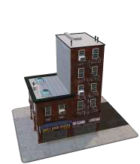














Enterprise-grade security

Slide 7

























Industry-leading compliance
ISO 27001 | SOC 1 Type 2 | SOC 2 Type 2 | PCI DSS Level 1 | Cloud Controls | ISO 27018 | Content Delivery and | Shared
 |  |  |  | Matrix |  | Security Association | Assessments
FedRAMP JAB | HIPAA / | FIPS 140-2 | 21 CFR | FERPA | DISA Level 2 | CJIS | IRS 1075 | ITAR-ready | Section 508
P-ATO | HITECH |  | Part 11 |  |  |  |  |  | VPAT
European Union | EU Safe | United | China Multi | China | China | Singapore | Australian | New Zealand | Japan | ENISA
Model Clauses | Harbor | Kingdom | Layer Protection | GB 18030 | CCCPPF | MTCS Level 3 | Signals | GCIO | Financial Services | IAF
 |  | G-Cloud | Scheme |  |  |  | Directorate

Slide 8



Comprehensive Security
Category Feature
Data in Transit
Data Encryption at Rest
Data Discovery and Classification
Data Protection
Object Level Security (Tables/Views) Row Level Security
Column Level Security Dynamic Data Masking
Access Control
SQL Login
Azure Active Directory Multi-Factor Authentication
Authentication
Virtual Networks Firewall
Azure ExpressRoute
Network Security
Thread Detection
Auditing
Vulnerability Assessment
Threat Protection

Slide 9




Network Security - Business requirements
How do we implement network isolation?
Data at different levels of security needs to be accessed from different locations.
How do we achieve separation?
Disallowing access to entities outside the company’s network security boundary.
Data Protection
Access Control
Authentication
Network Security
Threat Protection

Slide 10



Azure networking: application-access patterns
Your Virtual Network
Users
Internet
Access to Synapse Analytics
BackEnd
Mid-tier
FrontEnd
Access to/from Internet
DDoS protection
Web application firewall Azure Firewall
Network virtual appliances
Service Endpoints
Backend Connectivity
ExpressRoute VPN Gateways
Access private traffic
Network security groups (NSGs) Application security groups (ASGs) User-defined routes (UDRs)

Slide 11
Securing with firewalls
Overview
By default, all access to your Azure Synapse Analytics is blocked by the firewall.
Firewall also manages virtual network rules that are based on virtual network service endpoints.
Internet
Microsoft Azure
SQL Data Warehouse firewall Server-level firewall rules
Rules
Allow specific or range of whitelisted IP addresses. Allow Azure applications to connect.
No
Client IP address in range?
Connection fails
Yes
DB 1
DB 2
DB 3

Slide 12

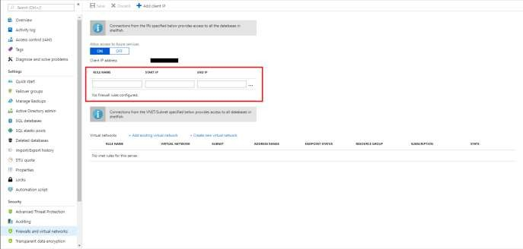
Firewall configuration on the portal
By default, Azure blocks all external connections to port 1433
Configure with the following steps:
Azure Synapse Analytics Resource:
Server name > Firewalls and virtual networks

Slide 13
Firewall configuration using REST API
Managing firewall rules through REST API must be authenticated.
For information, see Authenticating Service Management Requests.
Server-level rules can be created, updated, or
deleted using REST API.
To create or update a server-level firewall rule, execute the PUT method.
To remove an existing server-level firewall rule,
execute the DELETE method.
To list firewall rules, execute the GET.
PUT
https://management.azure.com/subscriptions/{subscriptionI
d}/resourceGroups/{resourceGroupName}/providers/Microsoft
.Sql/servers/{serverName}/firewallRules/{firewallRuleName
}?api-version=2014-04-01REQUEST BODY
{
"properties": { "startIpAddress": "0.0.0.3",
"endIpAddress": "0.0.0.3"
}
}
DELETE
https://management.azure.com/subscriptions/{subscriptionI d}/resourceGroups/{resourceGroupName}/providers/Microsoft
.Sql/servers/{serverName}/firewallRules/{firewallRuleName
}?api-version=2014-04-01
GET
https://management.azure.com/subscriptions/{subscriptionI d}/resourceGroups/{resourceGroupName}/providers/Microsoft
.Sql/servers/{serverName}/firewallRules/{firewallRuleName
}?api-version=2014-04-01

Slide 14
Firewall configuration using PowerShell/T-SQL
Windows PowerShell Azure cmdlets
# PS Allow external IP access to SQL DW PS C:\> New-AzureRmSqlServerFirewallRule
-ResourceGroupName "myResourceGroup" `
-ServerName $servername `
-FirewallRuleName "AllowSome"
-StartIpAddress "0.0.0.0"
-EndIpAddress "0.0.0.0“
-- T-SQL Allow external IP access to SQL DW EXECUTE sp_set_firewall_rule
@name = N'ContosoFirewallRule’, @start_ip_address = '192.168.1.1’,
@end_ip_address = '192.168.1.10'
Transact SQL

Slide 15
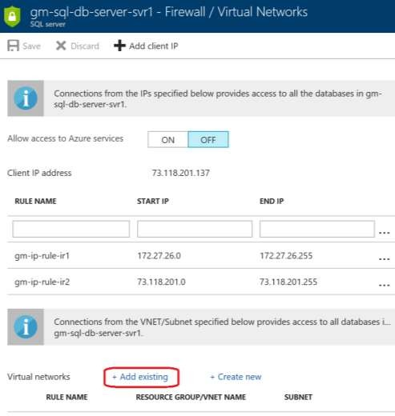
VNET configuration on Azure portal
Configure with the following steps:
Azure Synapse Analytics Resource:
Server name > Firewalls and virtual networks
REST API and PowerShell alternatives available
Note:
By default, VMs on your subnets cannot communicate
with your SQL Data Warehouse.
There must first be a virtual network service endpoint for the rule to reference.

Slide 16
Exercise 1-Securing Azure Synapse Analytics supporting infrastructure
Task 1: Observing the SQL Active Directory admin Task 2: Manage IP firewall rules Duration: 10 Minutes

Slide 17
BREAK [5 Minutes]

Slide 18
Module 2: Azure Active directory authentication

Slide 19
Authentication - Business requirements
How do I configure Azure Active Directory with Azure Synapse Analytics?
I want additional control in the form of multi-factor authentication
How do I allow non- Microsoft accounts to be able to authenticate?
Data Protection
Access Control
Authentication
Network Security
Threat Protection

Slide 20






Azure Active Directory authentication
Overview
Manage user identities in one location.
Enable access to Azure Synapse Analytics and other Microsoft services with Azure Active Directory user identities and groups.
Benefits
Alternative to SQL Server authentication
Limits proliferation of user identities across databases Allows password rotation in a single place
Enables management of database permissions by using
external Azure Active Directory groups
Eliminates the need to store passwords
Azure Synapse Analytics
Customer 1
Customer 2
Customer 3

Slide 21




Azure Active Directory trust architecture
Azure Active Directory and Azure Synapse Analytics
On-premises Active Directory
ADFS
Azure Active
Directory
Azure Synapse Analytics
ADALSQL
SQL Server Management Suite
ADO .NET
4.6
SQL Server Data Tools
Azure Active Directory Authentication Library for SQL Server (ADALSQL)
App

Slide 22
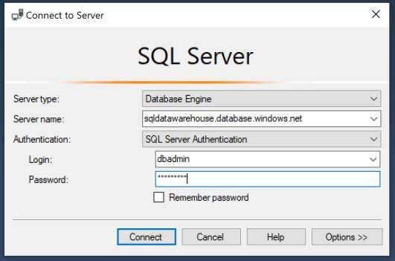
SQL authentication
Overview
This authentication method uses a username and password.
When you created the logical server for your data warehouse, you specified a "server admin" login with a username and password.
Using these credentials, you can authenticate to any database on that server as the database owner.
Furthermore, you can create user logins and roles with familiar SQL Syntax.
-- Connect to master database and create a login
CREATE LOGIN ApplicationLogin WITH PASSWORD = 'Str0ng_password'; CREATE USER ApplicationUser FOR LOGIN ApplicationLogin;
-- Connect to SQL DW database and create a database user CREATE USER DatabaseUser FOR LOGIN ApplicationLogin;

Slide 23






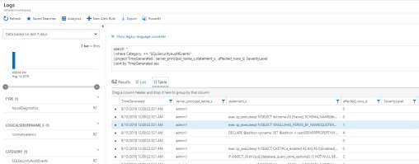
SQL auditing in Azure Log Analytics and Event Hubs
Gain insight into database audit log
Dashboards
Configurable via audit policy
SQL audit logs can reside in
Log Analytics
Power BI
Azure Storage account
Azure Log Analytics
Azure Event Hubs
Event Hubs
Azure Synapse Analytics
Audit Log
Blob Storage
Rich set of tools for
Investigating security alerts
Tracking access to sensitive data
Turn on SQL Auditing
Analyze audit log

Slide 24




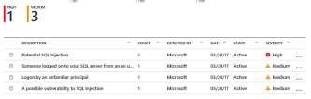



SQL threat detection
Detect and investigate anomalous database activity
Detects potential SQL injection
attacks
Detects unusual access & data exfiltration activities
(2) Possible threat to access / breach data
Actionable alerts to investigate & remediate
View alerts for your entire Azure tenant using Azure Security Center
Apps
Azure Synapse Analytics
Audit Log
Threat Detection
(1) Turn on Threat Detection
(3) Real-time actionable alerts

Slide 25
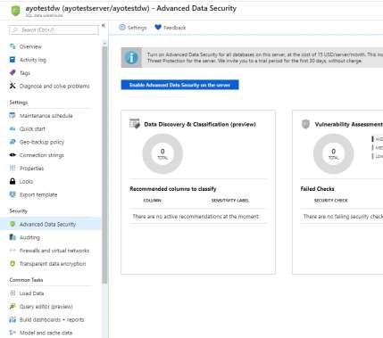
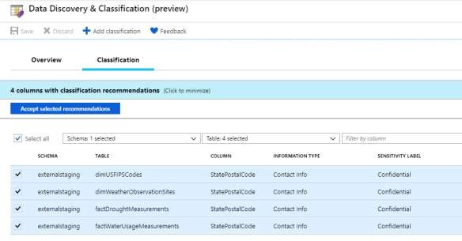
SQL Data Discovery & Classification - setup
Step 1: Enable Advanced Data Security on the logical SQL Server
Step 2: Use recommendations and/or manual classification to classify all the sensitive columns in your tables

Slide 26

Access Control - Business requirements
How do I restrict access to sensitive data to specific database users?
How do I ensure users only have access to relevant data?
For example, in a hospital only medical staff should be allowed to see patient data that is relevant to them—and not every patient’s data.
Data Protection
Access Control
Authentication
Network Security
Threat Protection

Slide 27
Exercise 2 - Securing the Azure Synapse Analytics workspace and managed services Task 1: Managing secrets with Azure Key Vault Task 2: Use Azure Key Vault for secrets when creating Linked Services Task 3 - Secure workspace pipeline runs Task 4 - Secure Azure Synapse Analytics dedicated SQL pools Duration: 45 Minutes

Slide 28
BREAK [5 Minutes]

Slide 29
Module 3: Objects – level security(tables and views)

Slide 30
Object-level security (tables, views, and more)
Overview
GRANT controls permissions on designated tables, views, stored procedures, and functions. Prevent unauthorized queries against certain tables.
Simplifies design and implementation of security at the database level as opposed to application level.
-- Grant SELECT permission to user RosaQdM on table Person.Address in the AdventureWorks2012 database GRANT SELECT ON OBJECT::Person.Address TO RosaQdM;
GO
-- Grant REFERENCES permission on column BusinessEntityID in view HumanResources.vEmployee to user Wanida GRANT REFERENCES(BusinessEntityID) ON OBJECT::HumanResources.vEmployee to Wanida with GRANT OPTION;
GO
-- Grant EXECUTE permission on stored procedure HumanResources.uspUpdateEmployeeHireInfo to an application role called Recruiting11 USE AdventureWorks2012;
GRANT EXECUTE ON OBJECT::HumanResources.uspUpdateEmployeeHireInfo TO RECRUITING 11; GO

Slide 31


Row-level security (RLS)
Overview
Fine grained access control of specific rows in a database table.
Help prevent unauthorized access when multiple users share the same tables.
Eliminates need to implement connection filtering
in multi-tenant applications.
Administer via SQL Server Management Studio or SQL Server Data Tools.
Easily locate enforcement logic inside the database and schema bound to the table.
Customer 1
Customer 2
Customer 3
SQL Data Warehouse

Slide 32
Row-level security
Creating policies
Filter predicates silently filter the rows available to read operations (SELECT, UPDATE, and DELETE).
The following examples demonstrate the use of the CREATE SECURITY POLICY syntax
-- The following syntax creates a security policy with a filter predicate for the Customer table
CREATE SECURITY POLICY [FederatedSecurityPolicy]
ADD FILTER PREDICATE [rls].[fn_securitypredicate]([CustomerId]) ON [dbo].[Customer];
-- Create a new schema and predicate function, which will use the application user ID stored in CONTEXT_INFO to filter rows.
CREATE FUNCTION rls.fn_securitypredicate (@AppUserId int) RETURNS TABLE
WITH SCHEMABINDING AS
RETURN (
SELECT 1 AS fn_securitypredicate_result WHERE
DATABASE_PRINCIPAL_ID() = DATABASE_PRINCIPAL_ID('dbo') -- application context AND CONTEXT_INFO() = CONVERT(VARBINARY(128), @AppUserId));
GO

Slide 33
Row-level security
Three steps:
Policy manager creates filter predicate and security policy in T-SQL, binding the predicate to the patients table.
App user (e.g., nurse) selects from Patients table.
Security policy transparently rewrites query to apply filter predicate.
Policy manager
CREATE FUNCTION dbo.fn_securitypredicate(@wing int) RETURNS TABLE WITH SCHEMABINDING AS
return SELECT 1 as [fn_securitypredicate_result] FROM StaffDuties d INNER JOIN Employees e
ON (d.EmpId = e.EmpId)
WHERE e.UserSID = SUSER_SID() AND @wing = d.Wing;
CREATE SECURITY POLICY dbo.SecPol
ADD FILTER PREDICATE dbo.fn_securitypredicate(Wing) ON Patients WITH (STATE = ON)
Database
Security policy
Filter Predicate: INNER JOIN…
Nurse
Patients
SELECT * FROM Patients
SEMIJOIN APPLY dbo.fn_securitypredicate(patients.Wing);
Application
SELECT * FROM Patients
SELECT Patients.* FROM Patients,
StaffDuties d INNER JOIN Employees e ON (d.EmpId = e.EmpId) WHERE e.UserSID = SUSER_SID() AND Patients.wing = d.Wing;

Slide 34
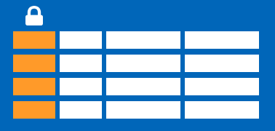
Column-level security
Overview
Control access of specific columns in a database table based on customer’s group membership or execution context.
Simplifies the design and implementation of security by putting restriction logic in database tier as opposed to application tier.
Administer via GRANT T-SQL statement.
Both Azure Active Directory (AAD) and SQL authentication are supported.

Slide 35
Column-level security
Three steps:
Policy manager creates permission policy in T-SQL, binding the policy to the Patients table on a specific group.
App user (for example, a nurse) selects from Patients table.
Permission policy prevents access on sensitive data.
Policy manager
CREATE TABLE Patients ( PatientID int IDENTITY, FirstName varchar(100) NULL, SSN char(9) NOT NULL,
LastName varchar(100) NOT NULL, Phone varchar(12) NULL,
Email varchar(100) NULL
);
Database
Patients
Nurse
Application
SELECT * FROM Membership;
Msg 230, Level 14, State 1, Line 12
The SELECT permission was denied on the column 'SSN' of the object 'Membership', database 'CLS_TestDW', schema 'dbo'.
Permission policy
GRANT SELECT ON Patients (
PatientID, FirstName, LastName, Phone, Email
) TO Nurse;
Allow ‘Nurse’ to access all columns except for sensitive SSN column
Queries executed as ‘Nurse’ will fail if they include the SSN column

Slide 36
Data Protection - Business requirements
How do I protect sensitive data against unauthorized (high-privileged) users?
What key management options do I have?
Data Protection
Access Control
Authentication
Network Security
Threat Protection

Slide 37
Dynamic Data Masking
Overview
Prevent abuse of sensitive data by hiding it from users
Easy configuration in new Azure Portal
Policy-driven at table and column level, for a defined set of users
Data masking applied in real-time to query results
based on policy
Multiple masking functions available, such as full or partial, for various sensitive data categories
(credit card numbers, SSN, etc.)
Table.CreditCardNo
4465-6571-7868-5796
4468-7746-3848-1978
4484-5434-6858-6550
SQL Database
 | CreditCardNo
 | XXXX-XXXX-XXXX-5796
 | XXXX-XXXX-XXXX-1978
Real-time data masking, partial masking

Slide 38
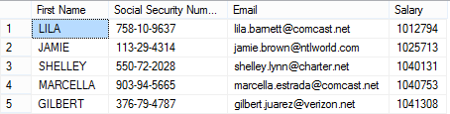

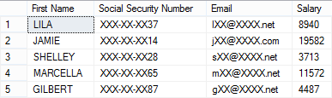
Dynamic Data Masking
Three steps
Security officer defines dynamic data masking policy in T-SQL over sensitive data in the Employee table. The security officer uses the built-in masking functions (default, email, random)
The app-user selects from the Employee table
The dynamic data masking policy obfuscates the sensitive data in the query results for non-privileged users
2
Business app
SELECT [First Name],
[Social Security Number], [Email],
[Salary] FROM [Employee]
3
Non-masked data (admin login)
ALTER TABLE [Employee]
ALTER COLUMN [SocialSecurityNumber]
ADD MASKED WITH (FUNCTION = 'DEFAULT()')
1
ALTER TABLE [Employee] ALTER COLUMN [Email]
ADD MASKED WITH (FUNCTION = 'EMAIL()')
ALTER TABLE [Employee] ALTER COLUMN [Salary]
ADD MASKED WITH (FUNCTION = 'RANDOM(1,20000)')
GRANT UNMASK to admin1
Security officer
Masked data (admin1 login)

Slide 39
Exercise 3 - Securing Azure Synapse Analytics workspace data Task 1: Column Level Security Task 2: Row level security Task 3: Dynamic data masking Duration: 20 Minutes

Slide 40
Challenge – End to End Synapse Analytics Time – 4-5 hours.

Slide 41

Thank You for your attention!
Any Questions

